Slide 1
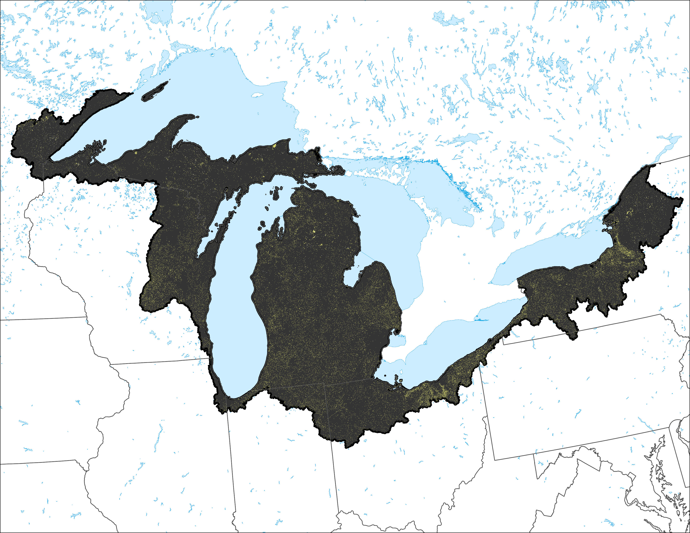
Ruderal lands for entire analysis area

Slide 2
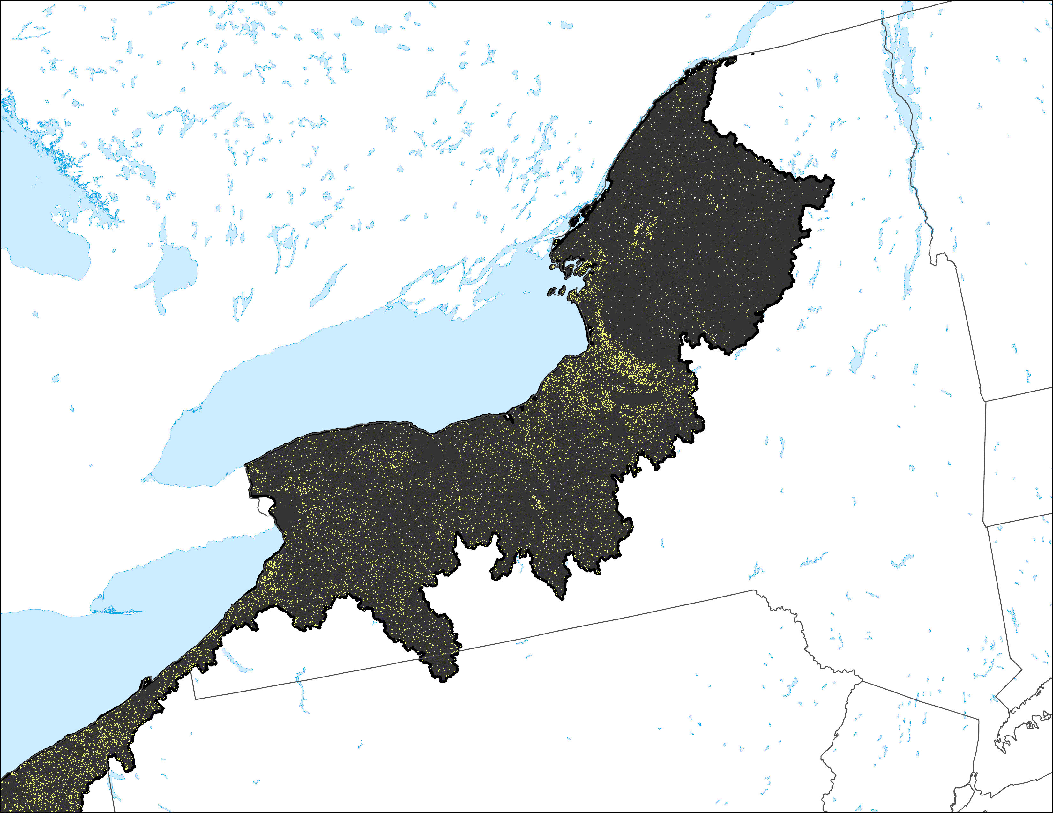
Ruderal lands New York section of analysis area

Slide 3
